Slide 1
Fabric Data Science
Henri Schulte Partner Solution Architect Microsoft Denmark

Slide 2









Microsoft Fabric The data platform for the era of AI
New Slide (00:56)
Data
Factory
Synapse Data
Engineering
Synapse Data
Science
Synapse Data Warehousing
Synapse Real
Time Analytics
Power BI
Data
Activator
OneLake

Slide 3


Data science in MS Fabric End-to-end data science for predictive business insights
Developer friendly
SaaS experiences with quick setup
Code authoring experiences in Notebooks and IDE
VS Code integration
Rich ML tools
Supports MLFlow model and experiment management
Built-in, scalable ML tools with SynapseML
Direct Lake mode for serving predictions to BI reports
Promotes collaboration
Unified platform for all analytics roles incl. data scientists
Secure and easy sharing of data, code, models and experiments
Data Centric
Easy and secure access to lake-centric data
Open Delta Lake support promotes reproducibility
Native integration with data infrastructure
Notes:
Why?

Slide 4
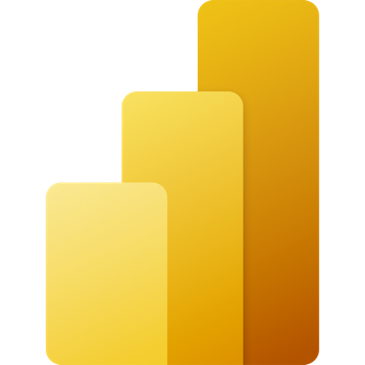
Data science
Data Source
Clean & prepare
Store
Expose
Lakehouse & Data Warehouse
Notebooks
Lakehouse(s)
PBI
Train test & apply
Lake Warehouse
Models
Experiments
Notes:
The Data Science analytics scenario can be ingested similarly to the Lakehouse and Data Warehouse paths.
Once the data is ingested, it is cleaned and prepared using notebooks and then stored in the Lakehouse with medallion structure.
After the data is cleaned and stored, machine learning models can be trained and tested directly on the Lakehouse.
Like the other analytics scenarios, business users can analyze and visualize the data with Power BI using the see-through mode or SQL endpoints.

Slide 5
The data science process
Problem formulation/ideation
Experiment and Model
Insight
Data discovery and pre-processing
Prepare
Model
Enrich and
Operationalize
Explore
Evaluate

Slide 6





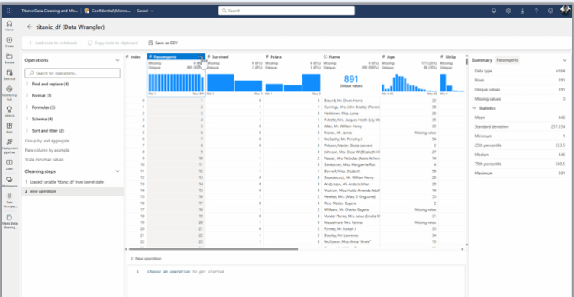

Data science for business insights
Problem formulation/ideation
Experiment and Model
Insight
SynapseML
Data discovery and pre-processing
Prepare
Model
Enrich and
Operationalize
Explore
Evaluate
Batch
PREDICT
Direct Lake
Data Wrangler
Notes:
We have a key scenario defined for Public Preview
Goal is to make this as smooth as possible
Not only scenario
Now let’s look at some experiences and features we ar eenabling

Slide 7
Code generation with Data Wrangler
Public Preview
Streamline data prep without sacrificing the power and reproducibility of Python
Dynamic data display
Built-in stats and charts
Pandas in a matter of clicks
Designed to onboard newer data scientists and to accelerate pro developers
Still to come: Spark support and NL-to-code functionality via Azure OpenAI

Slide 8
Models and experiments with MLFLow
Public Preview
Built-in model & experiment tracking enables data scientists to track and compare their different experiment runs and model versions
Automatically capture model metrics & parameters with built-in support for MLFlow auto-logging
Users can create and manage model and experiment items in Fabric
MLFlow model registry powered by Azure Machine Learning
Notes:
Autologging on by default

Slide 9
Code-first batch scoring with PREDICT
Public Preview
Scalable batch scoring with PREDICT simplifies operationalization of ML models
Supports MlFlow models
Predictions served seamlessly from a Lakehouse to BI reports with zero lead time

Slide 10
Low-code batch scoring with PREDICT
Public Preview
Get started with PREDICT directly from the UI, using a guided experience to deploy models in a matter of clicks
Select source data
Map it to your model's inputs
Choose an output destination
We'll handle the rest and generate code for you!

Slide 11

SynapseML Simple and distributed machine learning for Spark
Distributed ML model training
LightGBM
Vowpal Wabbit
Explainable boosting machines (preview)
MLFLow support
Full integration with MLFlow for Synapse ML models
Azure Cognitive Services
Integration with Azure Cognitive Services for scalable processing with pre-trained AI
Large language models
Integration with Azure Open AI large language models and embeddings
…and much more!

Slide 12
R Support
Public Preview
R language for Apache Spark:
Native support for SparkR, SparklyrR, Tidyverse, and popular visualization packages
Key library management capabilities
Available in both notebook and Spark Job Definitions
Enables data scientists to process data and develop ML models using familiar Spark and R interfaces

Slide 13
Time to try it out
Import example notebooks into your workspace
Create data visualizations in a notebook
Use Spark to clean and prepare your data
Train a machine learning model with SynapseML and mlflow
Register your model to track parameters and performance
Perform batch scoring with your ML model
Data science tutorial - get started - Microsoft Fabric | Microsoft Learn

